Slide 1


183 DB Weekly Report
Week 8 Team Parsley
Lin Li, Amir Omidfar, Wilson Chang, Angel Jimenez

Slide 2
Accuracy of controller
Exploring the PWM effects on the speed of the controller (scale of 0-100)
Not as sensitive as we expect, saturates at around 40
Demo of spinning at 5 and 20
Link
Notes:
PWM not changing the speed that much
Coding struggles

Slide 3
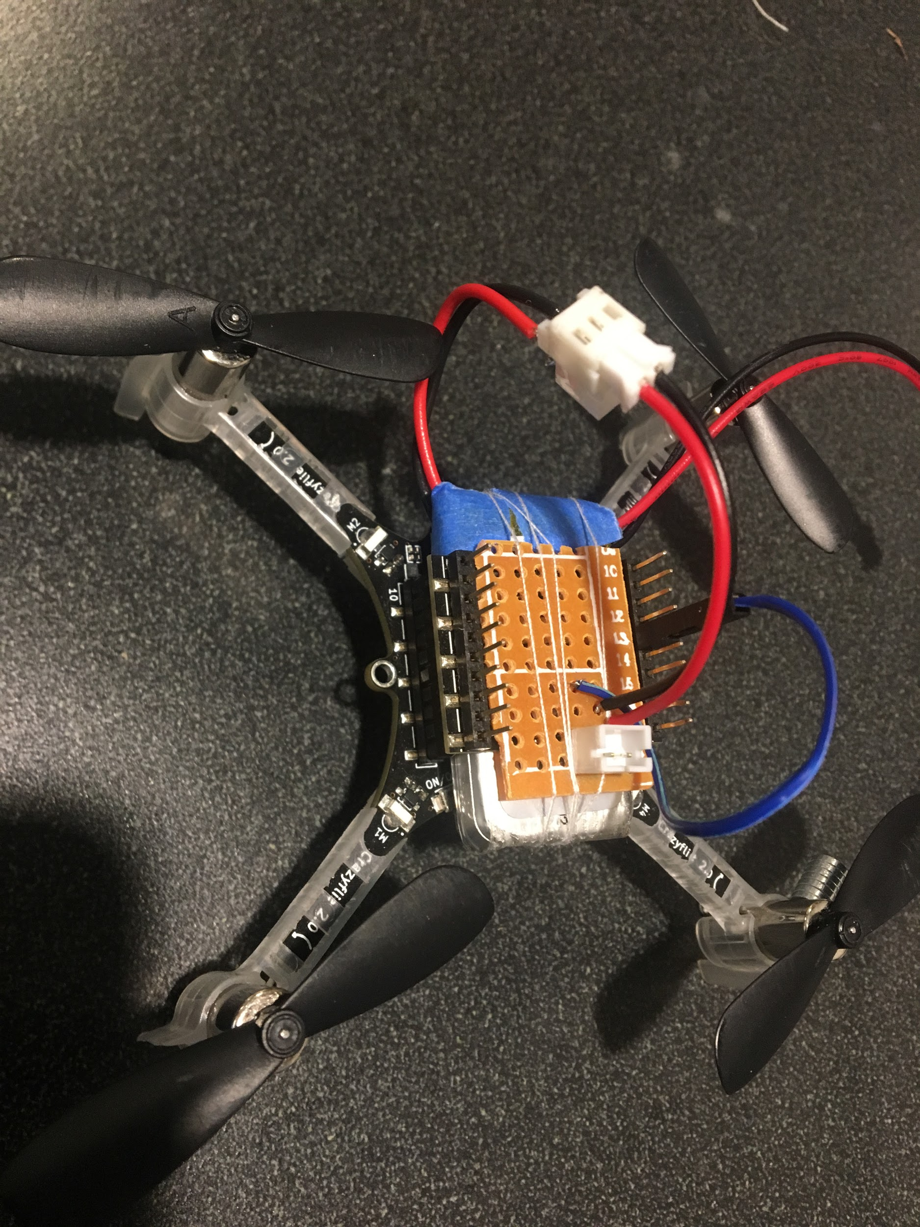
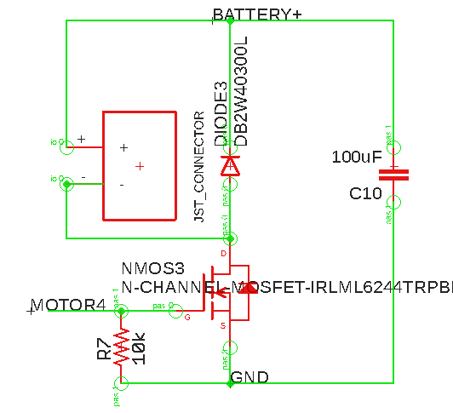
Testing the model with drone+spinning mass attached
Adding new connections to stick with one battery
Testing the module with different motor driver circuits
H-bridge
Switching Mosfet
SMD soldering
Two batteries
Demo

Slide 4
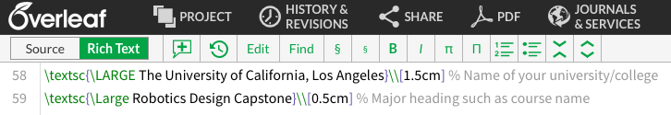
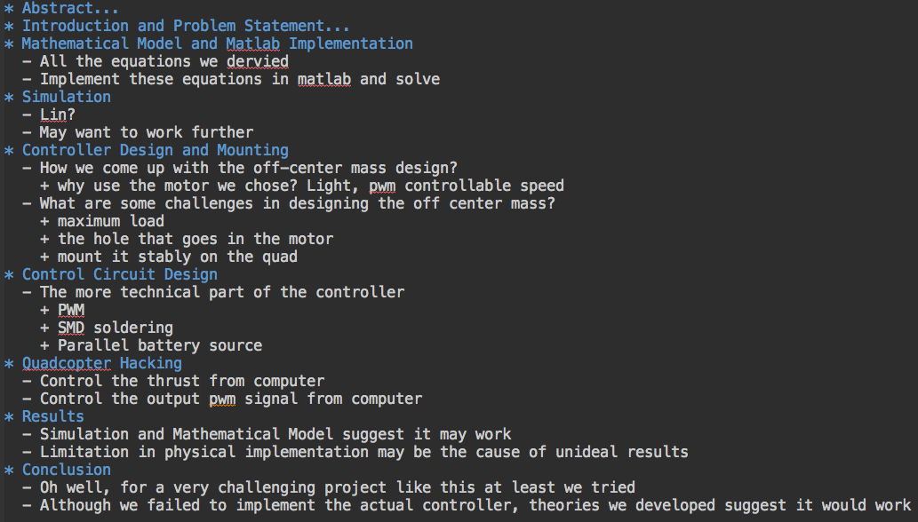
Documentation

Slide 5
Next Week Planning
End to end testing and final corrections
Capture a video demo
Documentation

Slide 6
References
https://www.bitcraze.io/2014/08/crazyflie-2-0-expansion-port/

Slide 7
